Slide 1
SCE’s Energy Education Centers
Friday, March 21, 2014

Slide 2
Table of Contents
Energy Education Center Overview . . . . . . . . . . . . . . . . . . . . . . . . . . . . . . . . . . . 3
EEC Educational Resources . . . . . . . . . . . . . . . . . . . . . . . . . . . . . . . . . . . . . . . . . . 4
EEC Unique Offerings – Irwindale . . . . . . . . . . . . . . . . . . . . . . . . . . . . . . . . . . . . . . 5
EEC Unique Offerings – Tulare . . . . . . . . . . . . . . . . . . . . . . . . . . . . . . . . . . . . . . . . . 6
Appendix . . . . . . . . . . . . . . . . . . . . . . . . . . . . . . . . . . . . . . . . . . . . . . . . . . . . . . . . . . 7
Course Curriculum
- Building Envelope, Construction & Software - Foodservice Technologies
- Commercial & Industrial Technologies - HVAC/R Technologies
- Demand Response - Lighting Technologies
- Electricity Fundamentals - Pumps & Water Delivery
- Energy Management Controls - Renewables
- Energy Strategies

Slide 3
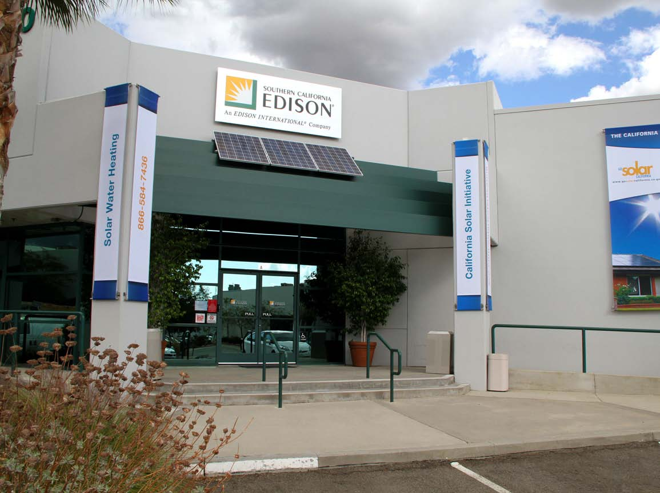
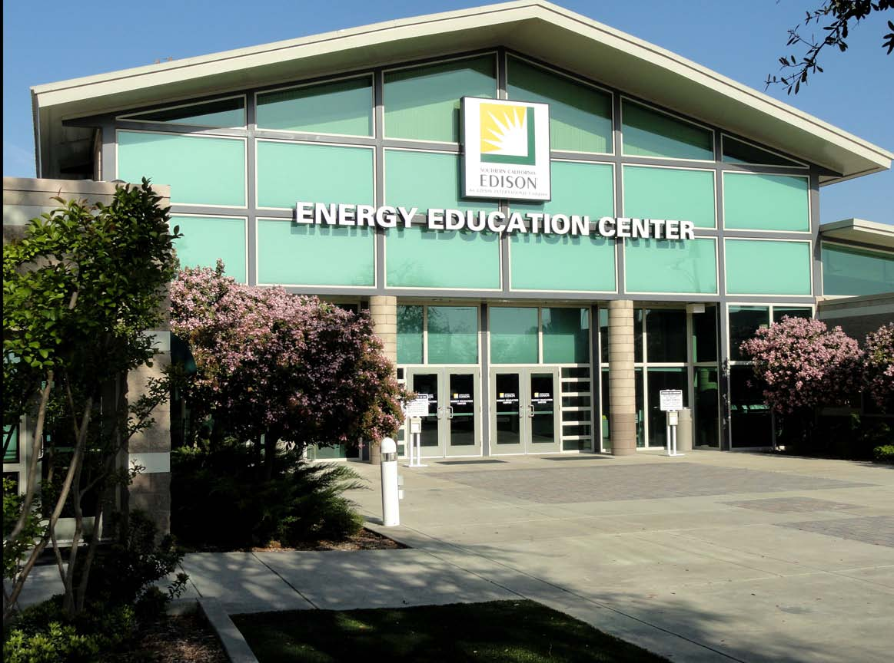
Energy Education Center Overview
Southern California Edison’s Energy Education Centers (EECs) in Irwindale and Tulare are resources for integrated energy efficiency, demand response and distributed generation education and training, using the latest in state-of-the-art technologies to instruct and demonstrate to our customers how to make better energy decisions for their homes and businesses.
Energy Education Center – Irwindale
6090 North Irwindale Blvd.
Irwindale, CA 91702
800-336-2822 – General
626-812-7508 - Fax
Energy Education Center – Tulare
4175 South Laspina Street
Tulare, CA 93274
800-772-4822 – General
559-625-7126 - Fax
SCE Internal Distribution Only

Slide 4
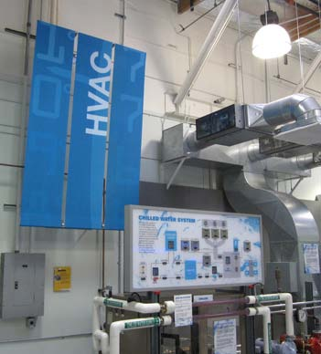
EEC Educational Resources
Classes and workshops are open to the public and SCE employees free of charge, and provide energy education in the areas of:
▪ Codes and Standards, Construction & Software ▪ Lighting Technologies
▪ Energy Management Controls ▪ Energy Strategies
▪ Electricity Fundamentals ▪ Foodservice Technologies
▪ Heating, Ventilating and Air Conditioning/Refrigeration (HVACR) ▪ Pumps & Water Delivery
▪ Solar – Commercial, Contractor ▪ Demand Response
▪ Commercial & Industrial Technologies
Many of the classes and workshops are accredited and count toward industry certification including:
▪ American Institute of Architects (AIA) Learning Units
▪ California Advanced Lighting Controls Training Program (CALCTP) Certification
▪ Institute of Heating & Air Conditioning Industries Inc. (IHACI) Certification
▪ North American Technician Excellence (NATE) Certification
▪ Building Operator Certification (BOC)
▪ Foodservice Consultants Society International (FCSI) Continuing Education Units (CEUs)
SCE Internal Distribution Only

Slide 5
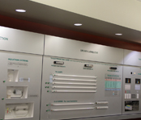
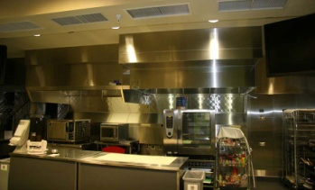
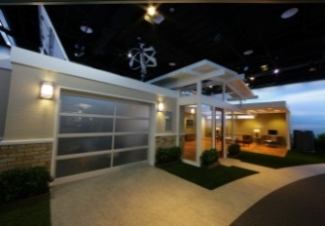
EEC-Irwindale Unique Offerings
The EEC-Irwindale also offers unique services to the public including the following:
THE LIGHTING ACADEMY
Designed for anyone interested in becoming more knowledgeable in energy-efficient lighting design, the Lighting Academy provides guidance for the application of the latest lighting technologies and most energy efficient designs in the industry today.
FOODSERVICE TECHNOLOGY CENTER
One of the unique areas available for meetings is the Foodservice Technology Center. The Center showcases the latest energy-efficient commercial foodservice technologies, and hosts cooking demonstrations and classes on how to reduce the foodservice business operating costs.
SMART ENERGY EXPERIENCE™
Experience the future of energy efficiency, smart grid technology and learn how SCE provides reliable power to our customers at the SMART ENERGY EXPERIENCE™. Both docent and self-guided tours are available Monday through Friday. To schedule a self-guided or docent-lead tour, email smarttours@sce.com
TOOL LENDING LIBRARY
Whether you are a California business or residential customer of SCE, you can borrow tools for free. Information for borrowing a tool is available via the SCE website at www.sce.com/workshops and scroll to the bottom of the page.
SCE Internal Distribution Only

Slide 6
EEC-Tulare Unique Offerings
The EEC-Tulare also offers unique services to the public including the following:
THE LIGHTING ACADEMY
Designed for anyone interested in becoming more knowledgeable in energy-efficient lighting design, the Lighting Academy provides guidance for the application of the latest lighting technologies and most energy-efficient designs in the industry today.
TOOL LENDING LIBRARY
Whether you are a California business or residential customer of SCE, you can borrow tools for free. Information for borrowing a tool is available via the SCE website at www.sce.com/workshops and scroll to the bottom of the page.
SCE Internal Distribution Only

Slide 7
Appendix

Slide 8
Course Curriculum
Building Envelope, Construction & Software
2013 Residential Standards Essentials for Energy Consultants
2013 Residential Title 24 Modeling Essentials
Advanced EnergyPro 6.1
EnergyPro 6.1 Software for Beginners
Nonresidential Title 24 Modeling Essentials
Residential Standards Essentials for Energy Consultants
Residential Title 24 Modeling Essentials
Title 24: Where We’re Headed with the 2013 Standards
Title 24: Where We’re Headed with the 2013 Standards (High Level Government Leaders)
EnergyPlus for Natural Ventilation Simulation Tool
HERS Advanced Rater Training Program: Advanced EnergyPro
HERS Advanced Rater Training Program: Manual D
HERS Advanced Rater Training Program: Manual J
HERS Advanced Rater Training Program: Manual S
HERS I Certification Class & Exam
HERS Raters Energy Code Enforcement – An Introduction for Building Code Enforcement Personnel
Best Practices for Measured Home Performance
Building Energy Science I – Preparation for Building Sealing
Building Energy Science II – Residential Air Sealing
Building Energy Science III – California Ventilation Options
DesignShift Charrette: Integrated Design for Zero Net Energy
LEED® Green Associate: Taking the First Step in Green Building Using LEED
Window Performance Essentials
Zero Net Energy Homes
Design Fundamentals
Enclosures & Assemblies
– Integrated Project Delivery
– Mechanical Systems
– People and Plug Loads
– Renewable Energy
Introduction to Thermal Imaging
SCE Internal Distribution Only

Slide 9
Course Curriculum
Commercial & Industrial Technologies
Benchmarking Energy Use in Commercial Buildings
Compressed Air System Efficiency
Industrial Refrigeration
Demand Response
Demand Response: Gain an Edge on Power Costs
Incorporating Demand Response Technologies and Strategies into the New Construction – Architects
Incorporating Demand Response Technologies and Strategies into the New Construction – Engineers and Consultants
Introduction to Demand Response: Benefits, Methods and Programs – Architects
Introduction to Demand Response: Benefits, Methods and Programs – Consultants and Engineers.
Electricity Fundamentals
Advanced Power Quality
Electric and Magnetic Field (EMF) Workshop
Electrical Safety
Electrical Systems Analysis
Fundamentals of Electricity and Energy Efficiency
Power Quality 101
Energy Management Controls
Energy Management Systems (EMS)
Programmable Logic Controllers (PLC) Industrial Electricity and Automated Controls
Introduction to Programmable Logic Controllers (PLC): Energy Efficiency Applications
Level 1
Level 2
Level 3
Level 4
SCE Internal Distribution Only

Slide 10
Course Curriculum
Energy Strategies
A Tool Day Workshop: An Overview of Applications from the Tool Lending Library
Continuous Energy Improvement Cohort Workshop
Getting Efficiency Projects Approved
Implementing Energy Efficiency Projects
Introduction to Continuous Energy Improvement
Leveraging Energy Efficiency Projects: Getting the Most for your Investment
Save Energy, Save Money: An Introduction to Energy Efficiency and Rebates
Thermal Energy Storage – Permanent Load Shifting – Customer Training
Thermal Energy Storage – Permanent Load Shifting – Engineer Training
Foodservice Technologies
2014 Foodservice Forecast
Case Studies: Energy Efficient Restaurant Upgrades that Save Money
Effective and Efficient Foodservice Lighting
Energy Efficiency Ice Machines
Energy Efficient electric Hot Water Systems
Energy Management Systems: Wiring the Intelligent Kitchen
Greener Restaurants
Hot Rebates and Cool Savings for Foodservice
Ice Machines – Energy Efficiency and Load Shifting Strategies
Innovative Foodservice Technologies and Efficiencies
Kitchen Ventilation: Demand Control
Kitchen Ventilation: Tips, Tricks and Technologies
Refrigeration Fundamentals
Smart Refrigeration
Specifying Energy Efficient Equipment
SCE Internal Distribution Only

Slide 11
Course Curriculum
Heating, Ventilating and Air Conditioning/Refrigeration (HVAC/R) Technologies
Advanced Quality Installation of Insulation (QII)
Air Handling System Efficiency
Basic Heating, Ventilating and Air Conditioning
CalCERTS Energy Star v3 / Special Energy Programs
CalCERTS Hands-On-Lab
CalCERTS HERS Basics
CalCERTS Independent Whole House Rater
CalCERTS Newly Constructed Homes (T-24)
CalCERTS Non-Residential Alterations (T-24)
Chilled Water System Efficiency
Chilled Water Systems and Cooling Towers
Efficient Technologies for Commercial Refrigeration
EPA 608 Type II – Certification
HVAC System Testing For Energy Efficiency
HERS Advanced Rater Training Program:
2013 Title 24 Part 6 Residential Overview
California Ventilation Options – ASRAE 62.2.2007 and 2010 Building Energy Series III
HERS Raters Energy Code Enforcement – An Introduction for Building Code Enforcement
Manual D
Manual J
Manual S
Residential Air Sealing – Building Energy Series II
HERS Building Pressure Diagnostics
HERS Hands-on Refrigerant Charge Measurement
HERS HVAC System Airflow Analysis
HERS II Multi-Family
HERS II Overview
SCE Internal Distribution Only

Slide 12
Course Curriculum
Heating, Ventilating and Air Conditioning/Refrigeration (HVAC/R) Technologies
IHACI (CAQI/QM/QS) Air Distribution Module:
Class 1 – Practical Fundamentals and Physical Properties of Air
Class 2 - Practical Fundamentals and Theory of Proper Air Distribution Design
Class 3 - Fundamental Theory and Techniques of Air Side Design and Installation
Class 4 – Advanced Theory and Techniques of Sir Side Design and Installation
IHACI (CAQI/QM/QS) Economizer Module:
Class 1 – Introduction/Fundamental Theory
Class 2 – Intermediate: Components, Installation/Maintenance
Class 3 – Advanced: Set-up, Control Strategies and Commissioning
Class 4 – Practical Hands-on Experience
IHACI (CAQI/QM/QS) HVAC System Diagnostics Module:
Class 1 – Practical Fundamentals, Theory, Methodology and Mind-Set of True System Diagnostics
Class 2 – Essential Field Techniques Required to Investigate the HVAC/R System
Class 3 – Evaluating, Analyzing and Ultimately Identifying the Root Cause(s) of the HVAC/R System
Class 4 – Accurate Elimination and Verification of the Root Cause(s) of the HVAC/R System
IHACI (CAQI/QM/QS) System Performance Module:
Class 1 – Thermodynamics: Heat in Motion
Class 2 – A Sub-System of the Building
Class 3 – Heating System: Comfort with Energy Efficiency
Class 4 – Cooling System: Comfort with Energy Efficiency
IHACI: (CAQI/QM/QS) Electrical Module:
Class 1 – Practical Fundamentals and Theory of HVAC/R System Electrical
Class 2 - Essential HVAC/R System Motor Theory for the Field Technician
Class 3 - Different Electrical Components Found in the HVAC/R Industry
Class 4 - Electrical Schematics: A Roadmap to Diagnosing A HVAC/R System
IHACI: (CAQI/QM/QS) AC/HP Refrigeration Module:
Class 1 – Practical Fundamentals and Theory of the Refrigeration Circuit
Class 2 – CAQI of Air Conditioning and Heat Pump Systems
Class 3 – CAQM of Air Conditioning and Heat Pump Systems
Class 4 – CAQS of Air Conditioning and Heat Pump Systems
SCE Internal Distribution Only

Slide 13
Course Curriculum
Heating, Ventilating and Air Conditioning/Refrigeration (HVAC/R) Technologies
IHACI: (CAQI/QM/QS) Gas Heating Module:
Class 1 – Practical Fundamentals and Theory of Gas Heating
Class 2 – Quality Installation, Maintenance and Service of Gas Heating Systems
IHACI: NATE Certification Training Series:
Air Conditioners and Heat Pumps: Part 1 (Introduction)
Air Conditioners and Heat Pumps: Part 2 (Installation & Service)
Air Distribution: Part 1 (Introduction)
Air Distribution: Part 2 (Installation & Service)
Core: Part 1 (General Skills)
Core: Part 2 (Electrical Skills)
Gas Heating: Part 1 (Introduction)
Gas Heating: Part 2 (Installation & Service)
NATE Certification Training Series Exam
Manometer Comparison (Retrotec vs. Energy Conservatory Equipment
Residential and Light Commercial HVAC
Retro-Commissioning (RCx) Fundamentals
Title 24 Building Energy Standards Essentials for Residential AC Quality Installation Contractors (2-day workshop)
Title 24 Building Energy Standards for Small Commercial AC Quality Installation Contractors (2-day workshop)
Title 24: Where We’re Headed with the 2013 Standards
Variable Refrigerant Flow Systems – Design and Application
SCE Internal Distribution Only

Slide 14
Course Curriculum
Lighting Technologies
Advanced Lighting Control Systems for Specifiers
Basics of LED Technology
Beyond Efficient Lamps
Calculating Lighting Solutions
Computer Aided Lighting Design
Designing Commercial Lighting
From Candles to LEDs – Getting to the Point
From Fluorescent to Induction – An Areas of Lamp Efficiency
Human Centric Lighting
Industrial Lighting Applications
Introduction to Lighting
Lighting Control Strategies and Devices
Lighting Design and Software: Indoor Calculation
Lighting Design Basics
Lighting Fixture Maintenance
Lighting for Contractors
Lighting Retrofit Strategies and Project Management Techniques
Office Lighting: Title 24 and Technology Update
Outdoor Lighting Applications
Residential Lighting: Title 24 and Technology Update
Retail Lighting: Title 24 and Technology Update
California Advanced Lighting Controls Training Program
CALCTP Business Development
CALCTP 10 Day Workshop
CALCTP 5 Day Workshop
CALCTP 2 Day Systems Workshop
SCE Internal Distribution Only

Slide 15
Course Curriculum
Pumps & Water Delivery
All Things Renewable
An Energy Tools Workshop for the Water Industry
Getting the Most from Your Electric Motor & VFD
Learn to Manage Your Usage and Help Control Your Cost
Managing Energy in Water and Wastewater Systems
Outage Communication for Water Customers
Pump Testing and Improving Your Pumping Plant Efficiency
What You Can Do About the Water-Energy-Carbon Connection
Renewables
California Solar Initiative Commercial Solar Workshop
California Solar Initiative Contractor Solar Class
Integrating Photovoltaics Into the Building
SCE Internal Distribution Only

